Slide 1





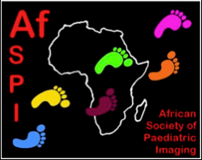
A Global Mapping of Pediatric Radiologists and Pediatric Radiology Training
Gloria Soto; Kara-Lee Pool; Cassandra Grageda; Amanda Dehaye; Hubert Ducou Le Pointe; Kath Halliday; Wendy Lam; Miguel A Lopez Pino; Hans-Joachim Mentzel; Gladys Mwango; Rutger Jan Nievelstein; Ines Boechat

Slide 2

Goals
This project aims to:
Establish the number of Pediatric Radiologists (as regionally defined) per country/region around the world
Outline the training pediatric radiologists receive and availability of training centers
Highlight major disparities and gaps in the availability of pediatric radiologists and pediatric imaging training
Based on this data create a road map for WFPI’s global efforts

Slide 3
Methods and Materials
A working group with representatives of the WFPI regional and national member societies was assembled to:
Define the information to be gathered via a survey, including how pediatric radiologists are defined in different countries/regions
Recruit contacts from different countries/regions responsible for responding to the survey (Appendix / slide 35)
Collate and analyze the data
Construct a Global map of Pediatric Radiologists and Pediatric Radiology training centers

Slide 4
Survey
1. How is a Pediatric Radiologist in “real practice” defined in your country/region?
  1-2 year training at an accredited training center “fellowship”
  4 or more months of optional training in pediatric imaging during the 4th or 5th year of a General Radiology Residence Program
  Non standardized training, by apprenticeship, after a radiology residence has been completed
  Non standardized training, by apprenticeship, of a non radiologist physician
  Other (explain)
2. Number of pediatric radiologists in the country (as defined in question 1)
3. Modality of training that pediatric radiologists receive
4. Number of accredited pediatric radiology training centers offering at least a 1 year long training period
5. Radiological equipment available in Pediatric Radiology training centers (if applies)

Slide 5
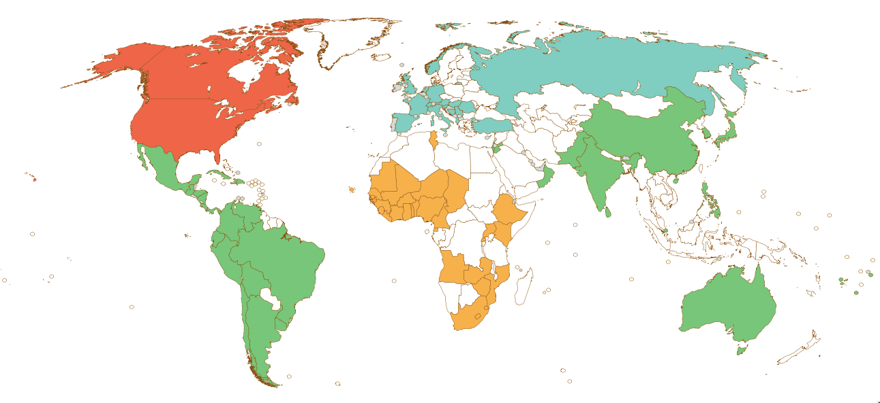
Results
88 Countries responded the survey
Africa: 34
Asia – Oceania: 16
Europe: 17
Latin America: 19
North America: 2

Slide 6
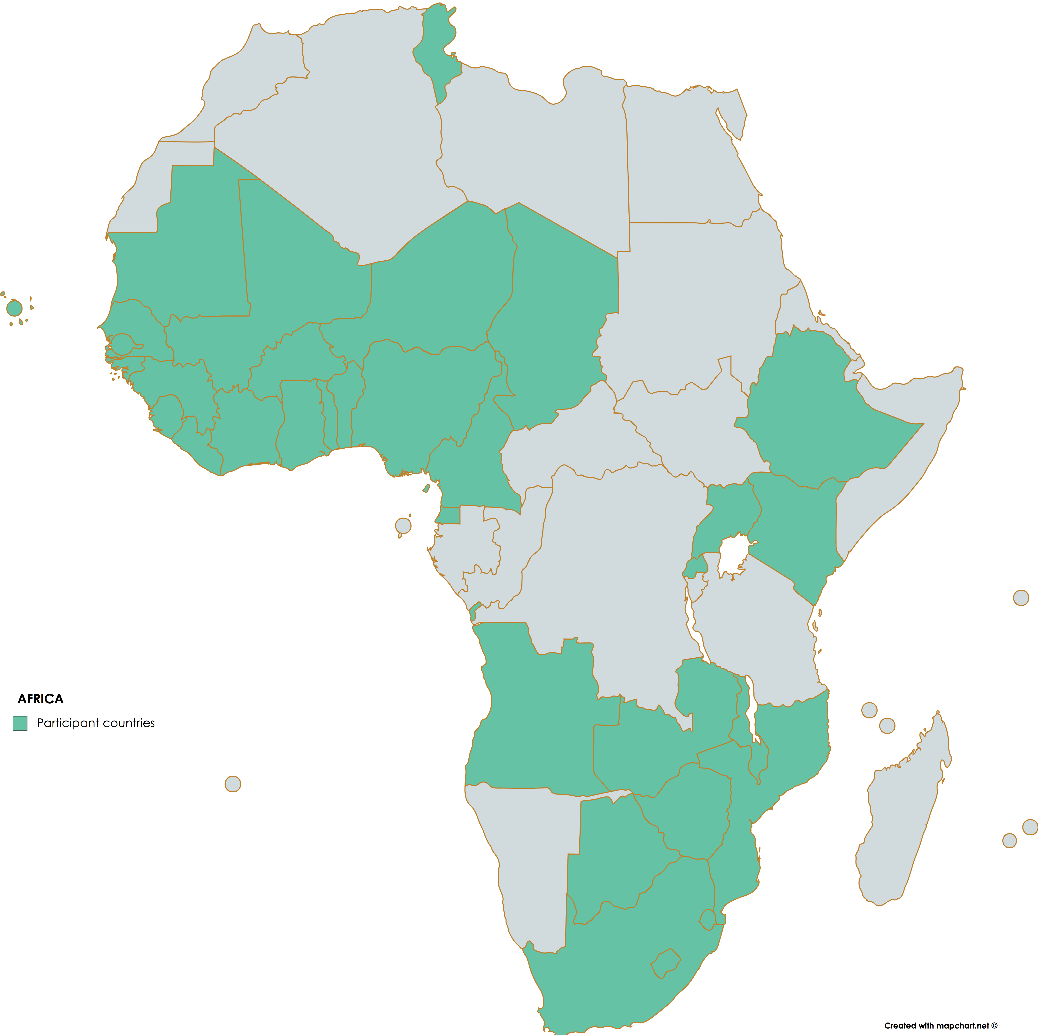
Africa
34 countries
Angola
Benin
Botswana
Burkina Faso
Cape Verde
Cameroon
Chad
Côte d’Ivoire
Equatorial Guinea
Ethiopia
Ghana
Guinea
Guinea-Bissau
Kenya
Lesotho
Liberia
Malawi
Mali
Mauritania
Mozambique
Niger
Nigeria
Nigeria
Rwanda
Senegal
Sierra Leone
South Africa
Swaziland
The Gambia
Togo
Tunisia
Uganda
Zambia
Zimbabwe

Slide 7
Africa
Availability of Pediatric Radiologists: 7/34 countries
Ethiopia
Kenya
Malawi
Nigeria
South Africa
Tunisia
Uganda
YES
NO

Slide 8
Africa
Definition of “Pediatric Radiologist” according to practice
MALAWI
NIGERIA
TUNISIA
UGANDA
ETHIOPIA
KENYA
SOUTH AFRICA
1-2yr FELLOWSHIP
APPRENTICESHIP

Slide 9
Africa
Pediatric Radiologists per country
1-2yr FELLOWSHIP
APPRENTICESHIP

Slide 10
Africa
Population < 19 years* / Pediatric Radiologist
1-2yr FELLOWSHIP
APPRENTICESHIP
*United Nations 2015

Slide 11
Africa
4 Pediatric Radiology training centers (1-2yr training) in 3 countries
100% availability
Digital Radiology
Fluoroscopy
Ultrasound
CT
MR
Partial availability
Nuclear Medicine: 2/3
No availability
PET CT

Slide 12
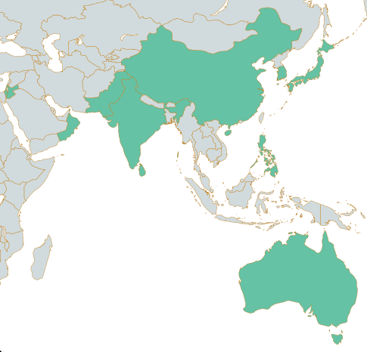
Asia Oceania
16 countries
Australia
China
Fiji
Hong Kong
India
Israel
Japan
Jordan
Korea
Oman
Pakistan
Philippines
Samoa
Singapore
Sri Lanka
Tonga

Slide 13
Asia - Oceania
Availability of Pediatric Radiologists:13/16 countries
FIJI
SAMOA
TONGA
OMAN
PAKISTAN
PHILIPPINES
SINGAPORE
SRI LANKA
YES
AUSTRALIA
CHINA
HONG KONG
INDIA
NO
ISRAEL
JAPAN
JORDAN
KOREA

Slide 14
Asia - Oceania
Definition of “Pediatric Radiologist” according to training
1-2yr FELLOWSHIP
HONG KONG
APPRENTICESHIP
JAPAN
PAKISTAN
1-2yr FELLOWSHIP OR APPRENTICESHIP
OPTIONAL TRAINING DURING 4th - 5th yr. RESIDENCY

Slide 15
Asia - Oceania
Pediatric Radiologists per country
>2000
1-2yr FELLOWSHIP
APPRENTICESHIP
1-2yr FELLOWSHIP OR APPRENTICESHIP
OPTIONAL TRAINING 4th-5th YR RESIDENCY

Slide 16
Asia - Oceania
Population < 19 years* / Pediatric Radiologist
9,378,714
1-2yr FELLOWSHIP
APPRENTICESHIP
1-2yr FELLOWSHIP OR APPRENTICESHIP
OPTIONAL TRAINING 4th-5th YR RESIDENCY
*United Nations 2015

Slide 17
Asia - Oceania
32 Pediatric Radiology training centers (1-2yr training) in 9 countries
100% availability
Digital Radiology
Fluoroscopy
Ultrasound
CT & MR
Partial availability
Nuclear Medicine
PET CT

Slide 18
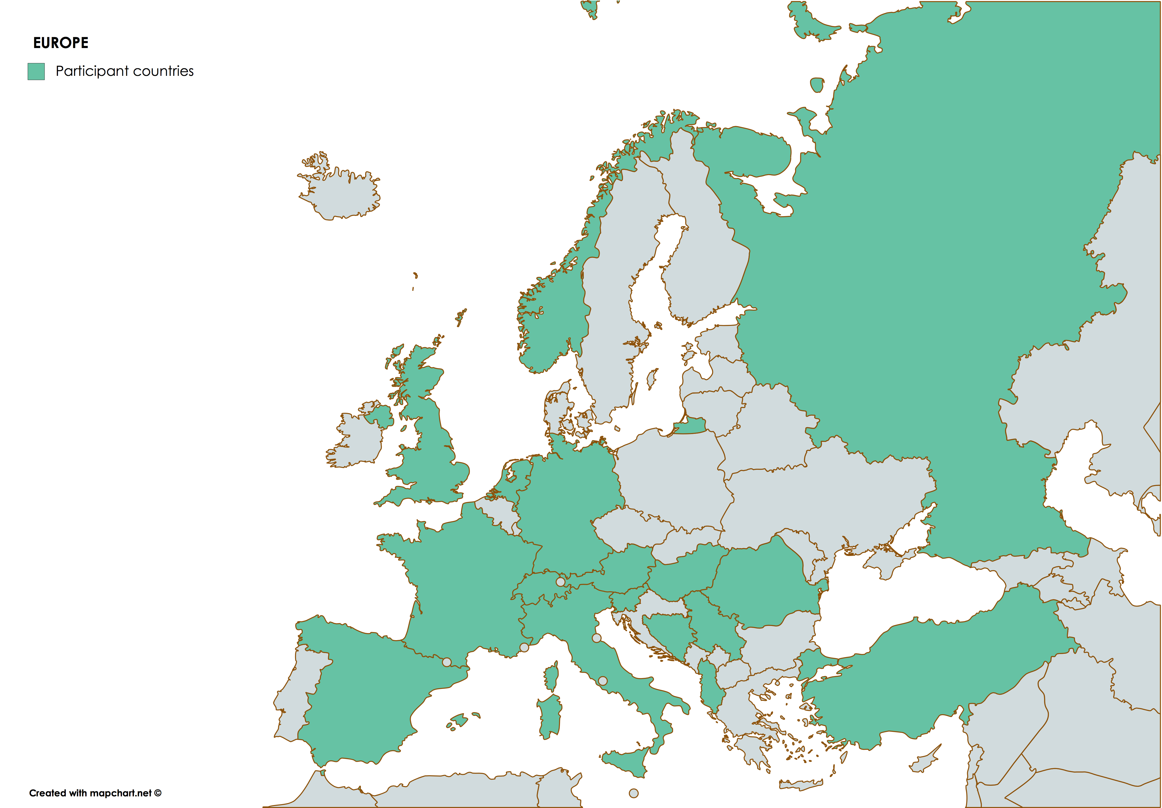
Europe
17 countries
Albania
Austria
Bosnia Herzegovina
France
Germany
Hungary
Italy
Netherlands
Norway
Romania
Russia
Serbia
Slovenia
Spain
Switzerland
Turkey
United Kingdom

Slide 19
Europe
Definition of “Pediatric Radiologist” according to training
ALBANIA
AUSTRIA
BOSNIA-HERZ
ITALY
RUSSIA
SERBIA
SLOVENIA
GERMANY
NORWAY
NETHERLANDS
SWITZERLAND

Slide 20
Europe
Pediatric Radiologists per country
1-2yr FELLOWSHIP
APPRENTICESHIP
1-2yr FELLOWSHIP OR APPRENTICESHIP
OPTIONAL TRAINING 4th-5th YR RESIDENCY
FELLOWSHIP OR OPTIONAL TRAINING 4th-5th YR RESIDENCY OR APPRENTICESHIP

Slide 21
Europe
Population < 19 years* / Pediatric Radiologist
1-2yr FELLOWSHIP
APPRENTICESHIP
1-2yr FELLOWSHIP OR APPRENTICESHIP
OPTIONAL TRAINING 4th-5th YR RESIDENCY
FELLOWSHIP OR OPTIONAL TRAINING 4th-5th YR RESIDENCY OR APPRENTICESHIP
*United Nations 2015

Slide 22
Europe
124 Pediatric Radiology training centers (1-2yr training) in 10 countries
100% availability
Digital Radiology
Fluoroscopy
US, CT & MR
Partial availability
Nuclear Medicine
PET CT

Slide 23
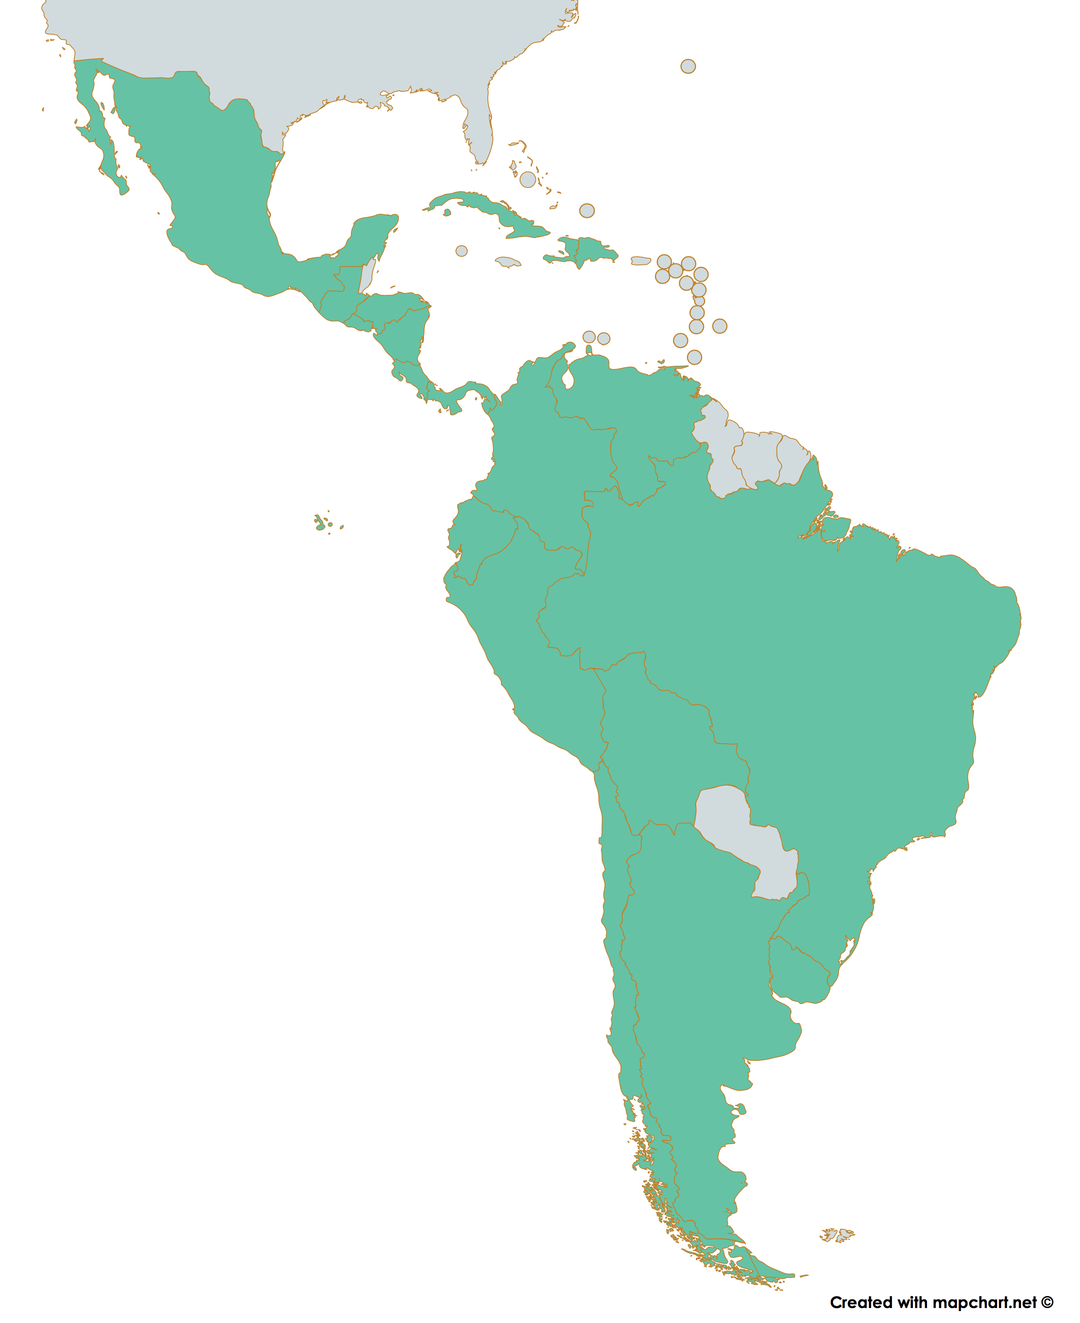
Latin America
19 countries
Argentina
Bolivia
Brazil
Chile
Colombia
Costa Rica
Cuba
Dominican Republic
Ecuador
El Salvador
Guatemala
Haiti
Honduras
Mexico
Nicaragua
Panama
Peru
Uruguay
Venezuela

Slide 24
Latin America
Definition of “Pediatric Radiologist” according to training
DOMINCAN REPUBLIC
ALBANIA
AUSTRIA
BOSNIA-HERZ
ITALY
RUSSIA
SERBIA
SLOVENIA
GERMANY
NORWAY
NETHERLANDS
SWITZERLAND

Slide 25
Latin America
Radiologists per country (17/18)
1-2yr FELLOWSHIP
APPRENTICESHIP
1-2yr FELLOWSHIP OR APPRENTICESHIP

Slide 26
Latin America
Population < 19 years* / Pediatric Radiologist
1-2yr FELLOWSHIP
APPRENTICESHIP
1-2yr FELLOWSHIP OR APPRENTICESHIP
*United Nations 2015

Slide 27
Latin America
9 Pediatric Radiology training centers (1-2yr training) in 5 countries
100% availability
Digital Radiology
Fluoroscopy
Ultrasound & CT
Partial availability
MR
Nuclear Medicine
PET CT

Slide 28
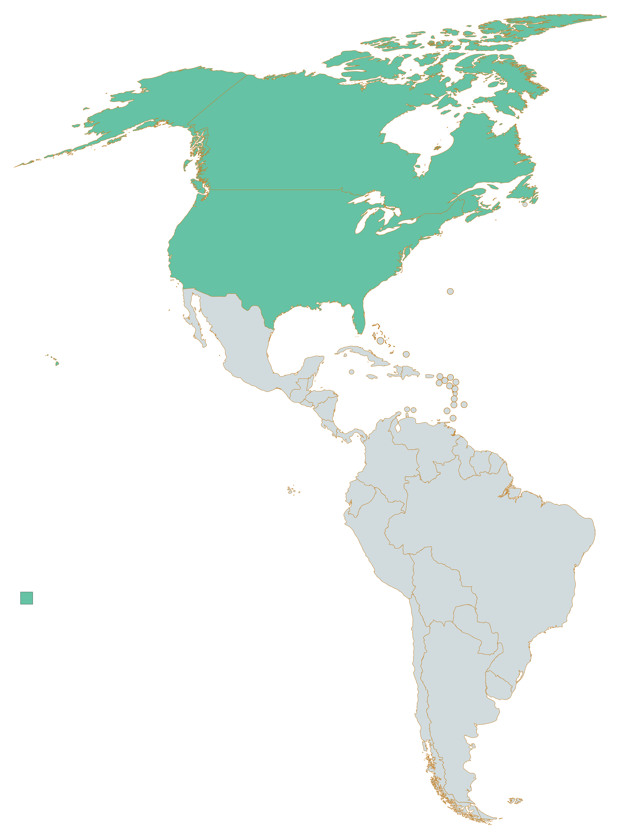
North America
2 countries *
Canada
United Sates of America
*Mexico included in Latin America

Slide 29
North America
Availability of Pediatric Radiologists: 2/2
In both countries a Pediatric Radiologist is defined as having completed a 1-2 year Fellowship training
Pediatric Radiologists per country
Population < 19 years* / Pediatric Radiologist

Slide 30
North America
54 Pediatric Radiology training centers (1-2yr training) in 2 countries
100% availability
Digital Radiology
Fluoroscopy
Ultrasound
CT
MR
NM
RIC/PACS
Tele-Radiology

Slide 31
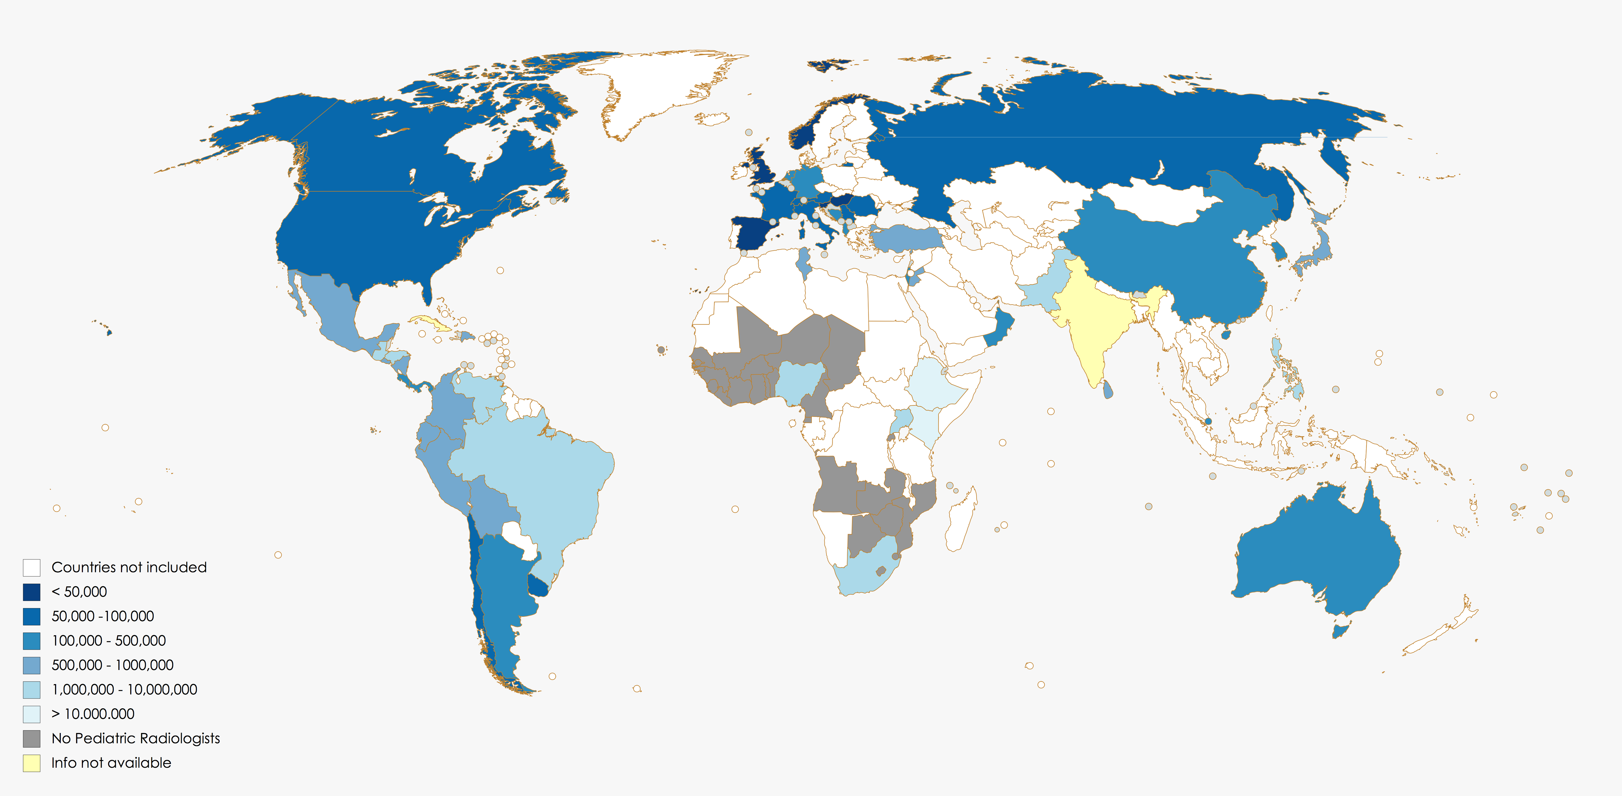
Global map of availability of Pediatric Radiologists
Population <19 years per Pediatric Radiologist / country
Conclusion

Slide 32
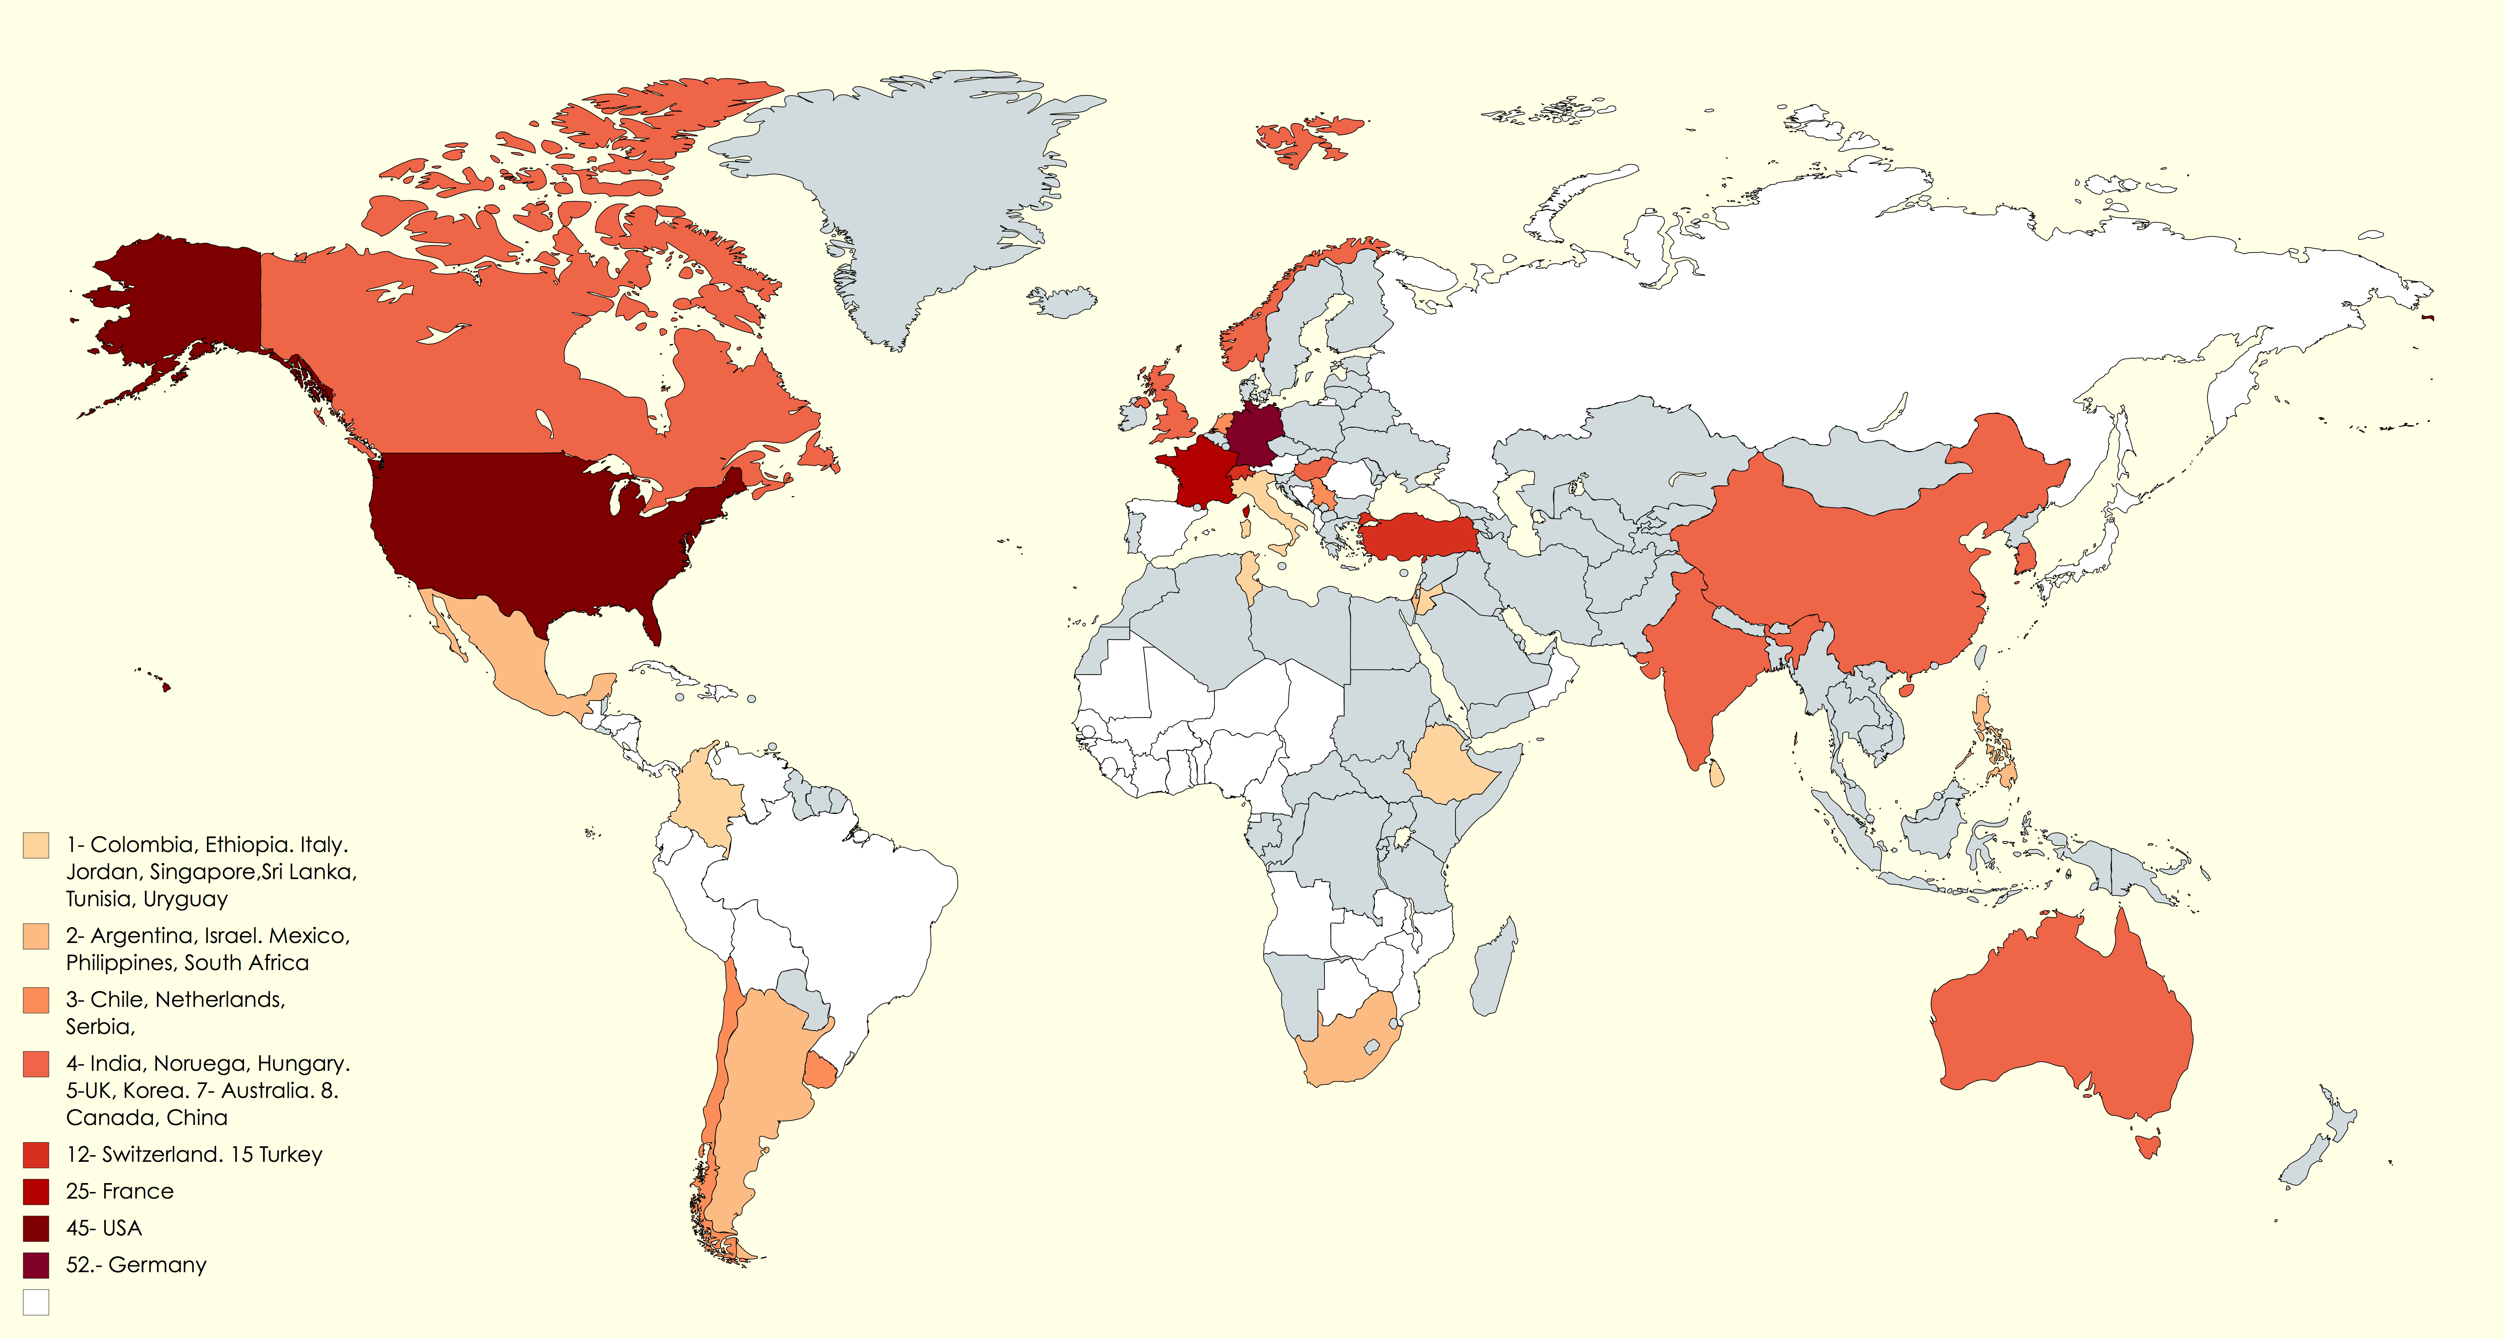
Global map of availability of Training Centers (absolute numbers)
Conclusion

Slide 33
Conclusion
Worldwide there is a broad definition of the title “Pediatric Radiologist” including different training pathways and length of sub-specialty training.
There is wide variability of available pediatric radiologists throughout the world, within the different regions, and within countries in a same region. The local definition of a “Pediatric Radiologist” is a factor to be considered when analyzing and comparing country and regional data.
There are major regional differences in the amount of training centers throughout the world.

Slide 34
Conclusion
The World Federation of Pediatric Radiology (WFPI) continues to play a large role in promoting better communication, collaboration, allocation of resources and education between regions. These are the core missions of WFPI.
The information obtained in this project will help focus the WFPI´s outreach programs according to the needs and availabilities of resources within each region /country.
Future directions of the WFPI may include recommending training pathways for Pediatric Radiologists according to local conditions and thus contribute to enhance the availability and quality of pediatric imaging worldwide.

Slide 35
Appendix: Key contacts and collaborators
AFRICA
Gladys Mwango
Jaishree Naidoo
Omolola Atalabi
Suzgo Sam Mzumara
Jean Jacques Nshizirungu
Azza Hammou
Kisembo Harriet Nalongo
Yocabel Gorfu
ASIA-OCEANIA
Wendy Lam
David Stringer
Marielle Fortier
Timothy Cain
Maggie Zhong
Kushaljit Sodhi
Shunsuke Nosaka
In-One Kim
Zeid Alaween
Bernard Laya
Kishani Pathirana
Qbal Dogar
Michalle Soudack
Komal Kritika Singh
Ana Akuola
Dilip Sankhla
Saud Al-Shabibi
Glenn Fatupaito
EUROPE
Fermin Saez
Miguel Angel Lopez Pino
HubertDucou le Pointe
Hans-Joachim Mentzel
Kath Halliday
Aleksandra Korostyshevskaya
Erich Sorantin
Sorin Dudea
Damjana Ključevšek
Rainer Wolf
Éva Kis
Goran Djuricic
Paolo Toma
Claudio Granata
Mithat Haliloglu
Irmina Sefic Pasic
Sonja (Saraci) Butorac
Rutger Jan Nievelstein
Lil Sofie Ording Müller
Charlotte de Lange
LATIN AMERICA
Mario Pelizzari
Lucrecia Postigo
Alexandra Monteiro
Gloria Soto
Federico Lubinnus
Luis Lobos
Miguel Ángel Allende
Víctor Izaguirre
Eysa Carrasco
María Isabel Barrantesmonges
Eric Chong
Patricia Compten
Luis Campos
Anabel Lizardi
José Briceño
Ernst Garcon
Fabián Gonzales
Beatriz González
Marta Eugenia Soissa
NORTH AMERICA
Inês Boechat
Donald Frush
Paul Babyn
Oscar Navarro
Karen Thomas

